Slide 1



Static Code Analysis Using
SonarQube
Java and Open Source Competency
Tech Mahindra’s Automation Program

Slide 2


TABLE OF CONTENT (Day-1)
SonarQube Overview and Features
SonarQube Architecture
SonarQube – Integration with ALM
Requirements
Installation
SonarQube - Configuration
Analysing Source Code

Slide 3
SonarQube- Overview and Features
SonarQube (previously known as Sonar) is an open source platform for Continuous Inspection of code quality.
SonarQube is written in java and supported for 25+ languages such as
Java, C/C++, C#, PHP, Flex, Groovy, JavaScript, Python, PL/SQL, COBOL etc., It is also supports Android Development projects.
It helps for various tasks and provide reports on
duplicated code, coding standards, unit tests, code coverage, complex code, potential bugs , comments and, design and architecture.
SonarQube is internally uses PMD, Find bugs, Check Style. Additionally plugins can be included according to project requirement.
Records metrics history and provides evolution graphs ("time machine") and differential views
Provides fully automated analyses using Maven, Ant, Gradle and Continuous Integration tools like Jenkins, Bamboo.
Integrates with the Eclipse development environment
Integrates with external tools like JIRA, Mantis, LDAP, Fortify
Implements the SQALE (Software Quality Assessment based on Lifecycle Expectations) methodology to compute technical debt

Slide 4
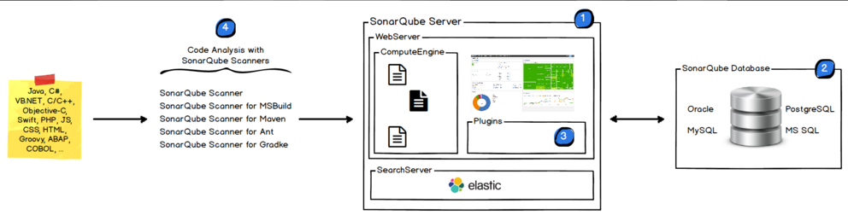
SonarQube- Architecture
The SonarQube Platform is made of 4 components mainly SonarQube Server, Database, Plugins and Scanners. Below are the architecture for SonarQube:
SonarQube Server: It contains mainly 2 process.
Web Server: For developers, managers to browse quality snapshot's
Search Server: Based on Elastic search to back searches from the UI
SonarQube Database: Configuration of the SonarQube instance (security, plugins settings, etc.) and the quality snapshots of projects, views etc.,
SonarQube Plugin: Installers on the server, possibly including language, SCM, integration, authentication, and governance plugins.
SonarQube Scanners: Running on your Build / Continuous Integration Servers to analyse projects

Slide 5
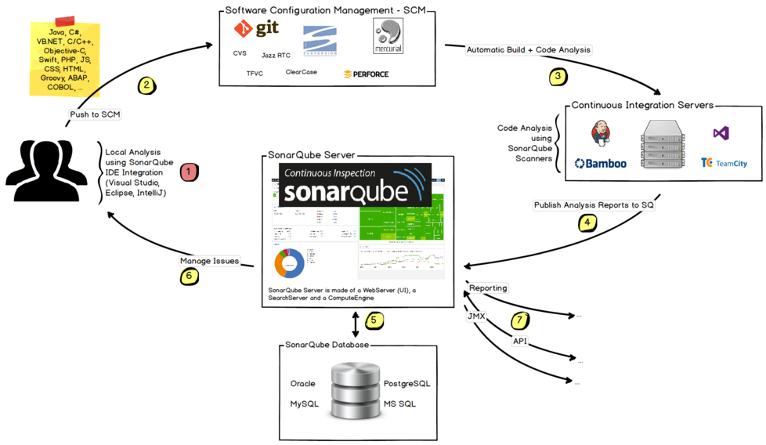
SonarQube- Integration with ALM
The following schema shows how SonarQube integrates with other ALM tools and where the various components of SonarQube are used:
Developers code in their IDEs and use Sonar Lint to run local analysis.
Developers push their code into SCM: GIT, SVN, TFVC, ...
The Continuous Integration Server triggers an automatic build, and the execution of the SonarQube Scanner for analysis
The analysis report is sent to the SonarQube Server for processing.
SonarQube Server processes and stores the analysis report results in the SonarQube Database
Developers review, comment, challenge their Issues to manage and reduce their Technical Debt through the SonarQube UI.
Managers receive Reports from the analysis.
Ops use APIs to automate configuration and extract data and JMX to monitor SonarQube Server.

Slide 6
SonarQube- Requirements
Prerequisite:
Java (Oracle JRE 7 onwards or OpenJDK 7 onwards)
Requires at least 2 GB of RAM and 50 GB HDD based on project needs
Java Script enabled browser(optional)
Supported Java Platforms:
SonarQube Java analyser is able to analyse any kind of Java source files regardless of the version of Java they comply to. But SonarQube analysis and the SonarQube Server require specific versions of the JVM.
Supported DB Platforms Supported Browser Platforms
JVM Version | Supported Version
Oracle JRE | 7u75+, 8
Open JDK | 7u55+, 8
IBM JRE / GCJ / Oracle JRocket | No Support
Data Base
MSSQL 2008 onwards
MySQL 5.1 onwards (only InnoDB)
Oracle 11G onwards
PostgreSQL 8.x onwards
Browser Support
IE 11 onwards
Mozilla Firefox
Google Chrome
Safari

Slide 7
SonarQube- Installation
Sonar Server:
Download and unzip the SonarQube distribution from below link
http://www.sonarqube.org/downloads/
Start the SonarQube server for executing below command :
On Windows, execute:
<<SonarQube path>>/bin/windows-x86-xx/StartSonar.bat
On other operating system, execute:
<<SonarQube path>>\/bin/[OS]/sonar.sh console
Browse the results at http://localhost:9000 (default System administrator user id and password are admin / admin)
Sonar Scanner: SonarQube Scanner is recommended as the default launcher to analyse the project with SonarQube server.
Download and unzip the SonarQube Scanner from the below link
http://docs.sonarqube.org/display/SONAR/Analyzing+with+SonarQube+Scanner
Update the global settings (server URL) updating <install_directory>/conf/sonar-runner.properties file in below lines:
#SonarQube server
#sonar.host.url=http://localhost:9000
Create a new SONAR_RUNNER_HOME environment variable set to <install_directory>/bin
Opening a new shell and executing the command sonar-runner -h

Slide 8
SonarQube- Configuration
SonarQube server will be configured by setting the values in [Sonar Home]/conf/sonar.properties file
Data base settings:
The default data base was H2. These values can be changed in <install_directory>/conf/sonar.properties:
sonar.jdbc.username=sonarqube
sonar.jdbc.password=mypassword
sonar.jdbc.url=jdbc:postgresql://localhost/sonarqube
Web Server Configuration:
The default port is "9000" and the context path is "/". These values can be changed in <install_directory>/conf/sonar.properties:
sonar.web.host=192.0.0.1
sonar.web.port=80
sonar.web.context=/sonar

Slide 9
SonarQube- Analyse Source Code
The following are the Code Analysis methods to analyze the code from Client machine.
SonarQube Scanner - Launch analysis from the command line
SonarQube Scanner for Ant- Launch analysis from Ant tool
SonarQube Scanner for Maven - Launch analysis from Maven with minimal configuration
SonarQube Scanner for Gradle - Launch Gradle analysis
SonarQube Scanner for MSBuild - Launch analysis of .NET projects
SonarQube Scanner For Jenkins - Launch analysis from Jenkins

Slide 10
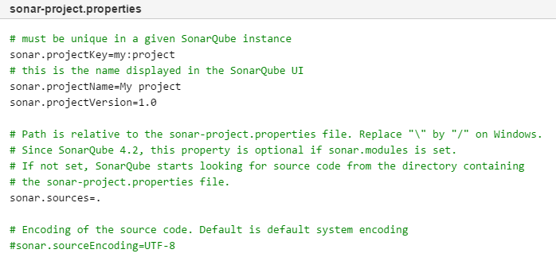
Analyse Source Code - Scanner
The SonarQube Scanner is recommended as the default launcher to analyse a project with SonarQube.
The following are the steps to execute “Simple Project”
Create a configuration file in the root directory for the project: sonar-project.properties
Run the following command from the project base directory to launch the analysis
sonar-runner in command line interface.

Slide 11
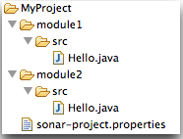
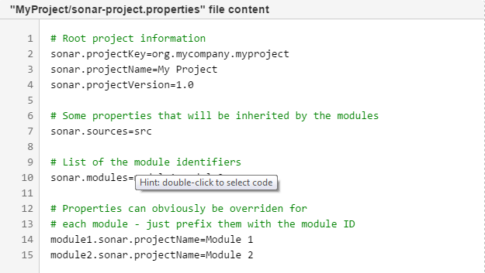
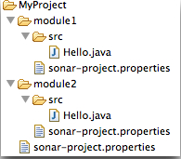
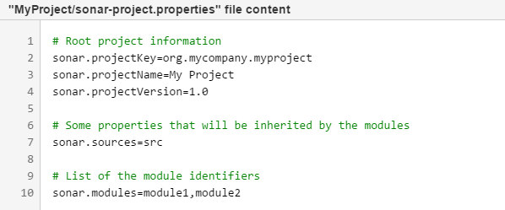


Analyse Source Code - Scanner
The following are the steps to execute “Multi-Module Project”. There are two ways to define a multi-module structure in SonarQube
Way 1 - Set all the configuration in the properties file in the root folder
Way 2 - Set all the configuration in the properties file in multiple folder

Slide 12
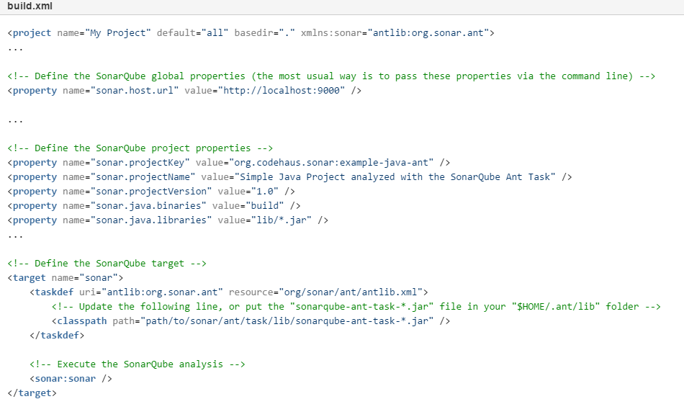
Analyse Source Code - ANT
The SonarQube Ant version 2.4 is compatible with SonarQube platform versions 4.5 and higher.
The following are the steps to execute “Simple Project”

Slide 13
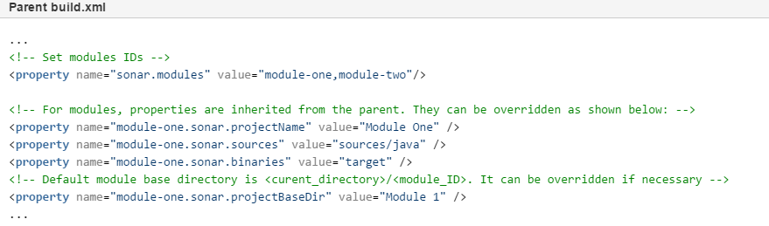
Analyse Source Code - ANT
The configuration for parent and modules must be done in the parent build.xml file:

Slide 14
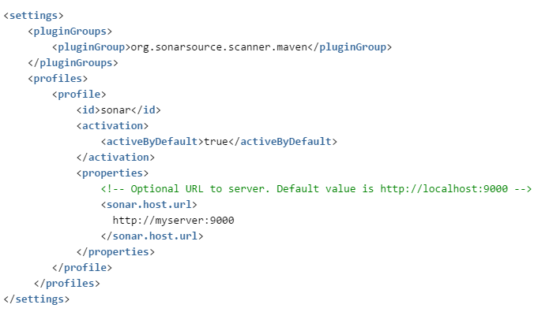
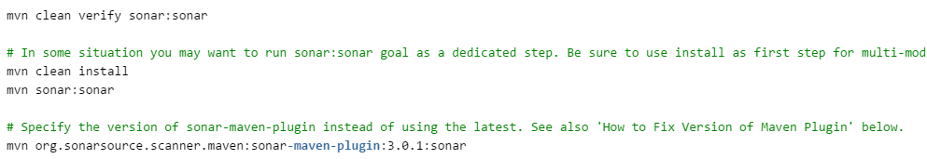
Analyse Source Code - Maven
The SonarQube requires Maven 3 to launch analysis of the project:
Global Setting (Optional): Configure global Maven Setting to support SonarQube
Analysing Maven Project: Analysing a Maven project consists of running a Maven goal - sonar:sonar in the directory where the pom.xml file resides

Slide 15
TABLE OF CONTENT (Day-2)
Browsing Dashboard
Browser Project
Plugin Library
Customizing User Interface
Quality Profiles
Coding New Rules
Eclipse Integration
Jenkins with SonarQube

Slide 16
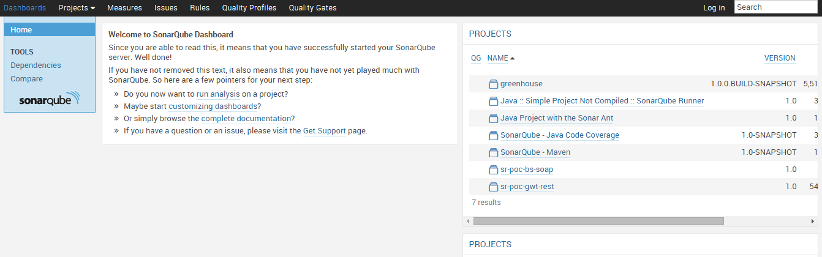
Dashboard
The following is the default view of the SonarQube. All user will view the below dashboard.

Slide 17
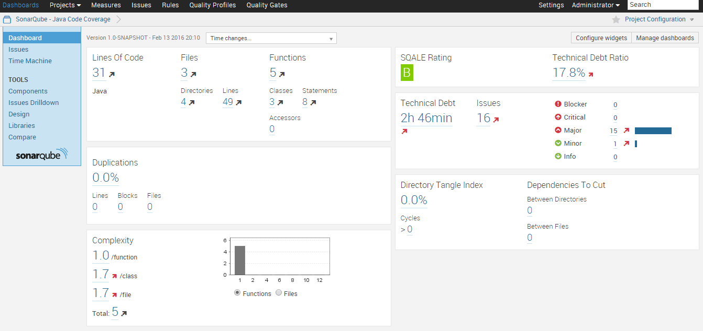
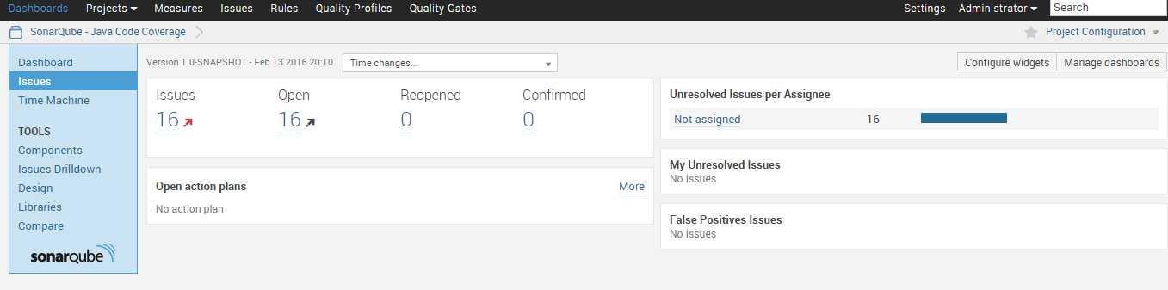
Project View
The following is the default view of the project. All user / admin will view the below dashboard.

Slide 18
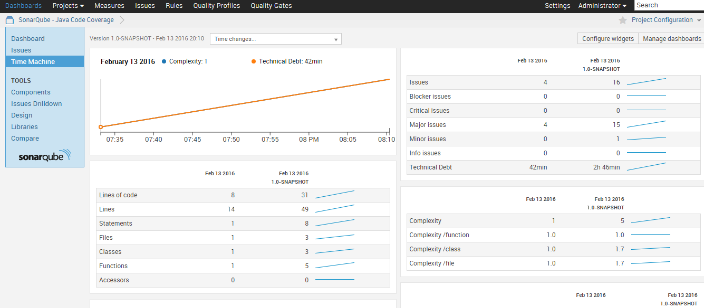
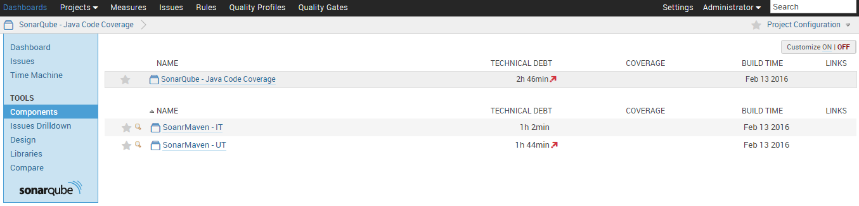
Project View
The following is the default view of the project. All user / admin will view the below dashboard.

Slide 19
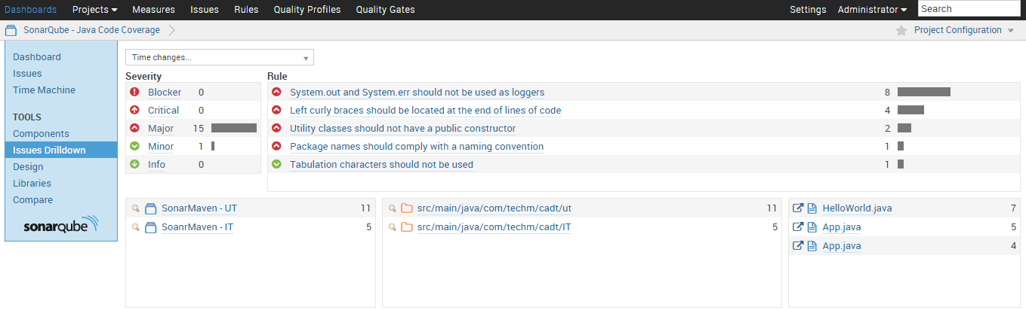
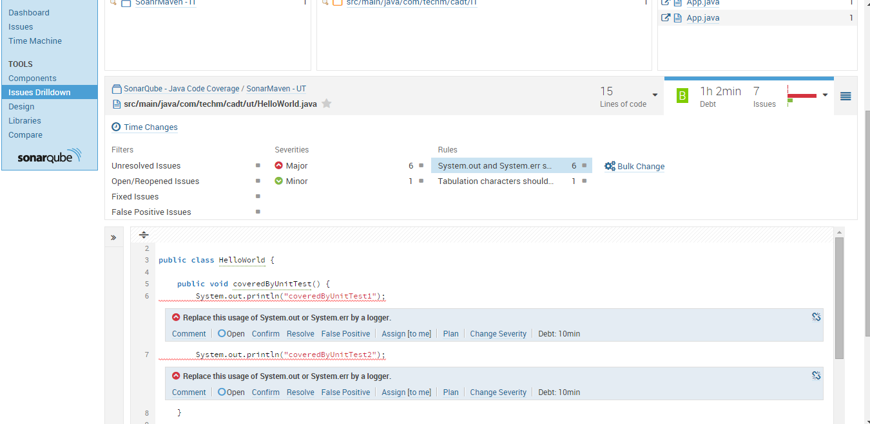
Project View
The following is the default view of the project. All user / admin will view the below dashboard.

Slide 20
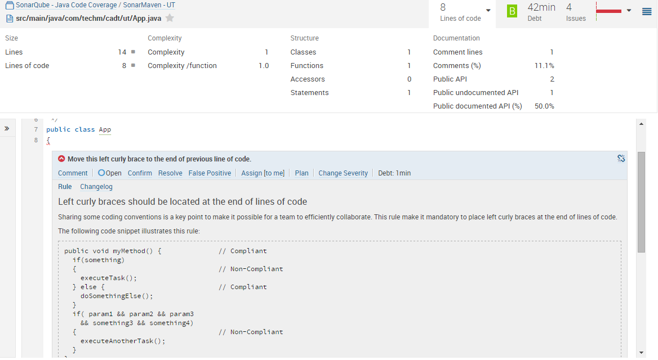
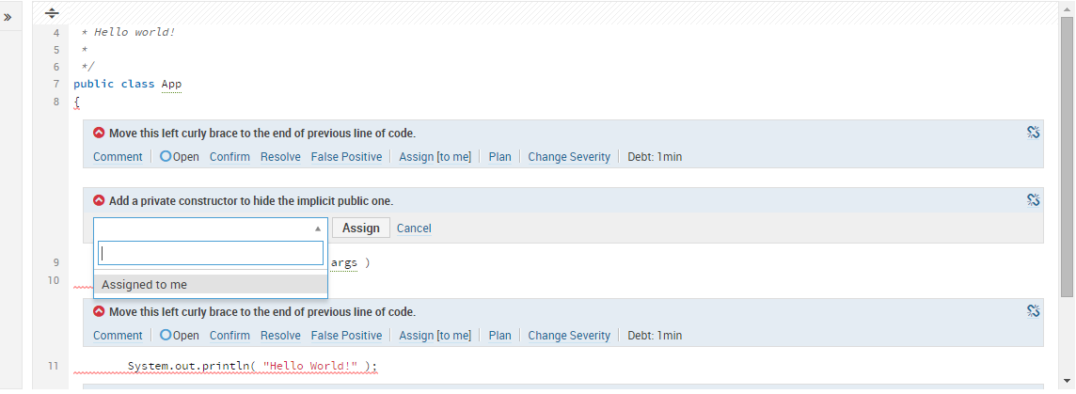
Project View
The following is the default view of the project. All user / admin will view the below dashboard.

Slide 21
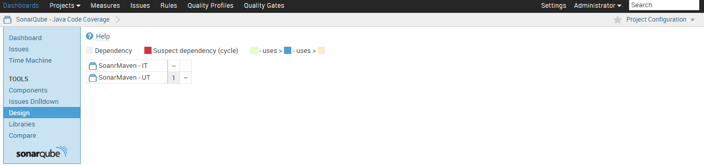
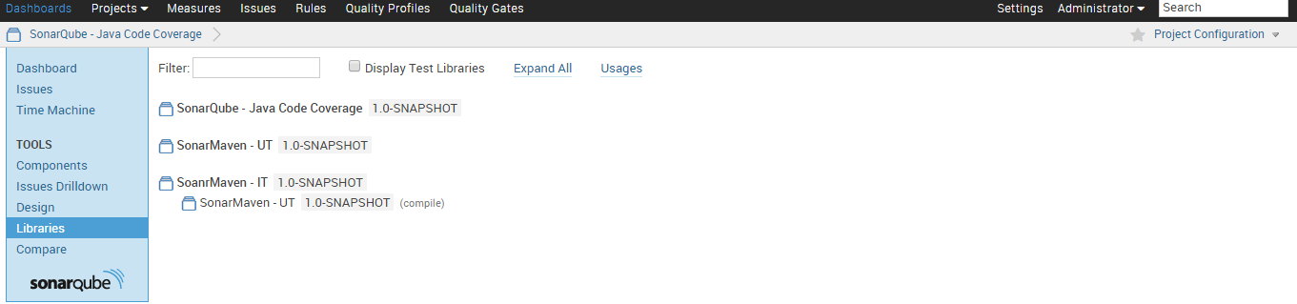
Project View
The following is the default view of the project. All user / admin will view the below dashboard.

Slide 22
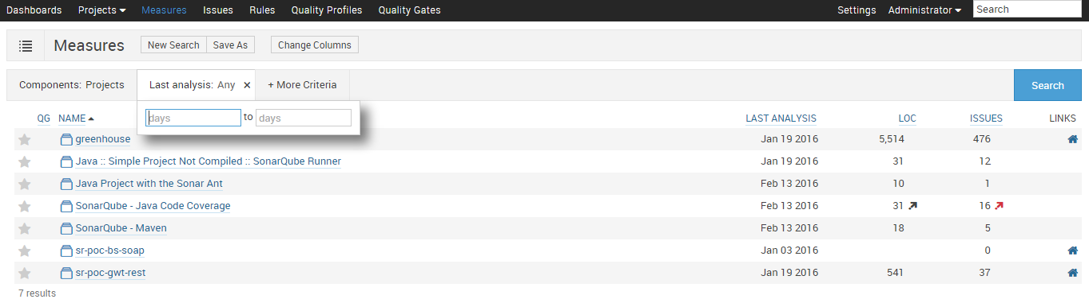
Project Measure
The Measures service provides a way to quickly execute all kinds of queries on project measures. Example:
the recently inspected projects
the projects with blocker and critical issues
the projects with bad coverage on added/changed code within the 10 past days
The search query can then be saved as a filter to be displayed on dashboards.

Slide 23
Project Measure
The Measures service provides a way to quickly execute all kinds of queries on project measures. Example:
the recently inspected projects
the projects with blocker and critical issues
the projects with bad coverage on added/changed code within the 10 past days
The search query can then be saved as a filter to be displayed on dashboards.

Slide 24
Jenkins - SonarQube Process Flow
Sonar
Install Sonar and Sonar Runner
Create Users and Groups in Sonar server using administration login
Jenkins
Install Jenkins
Login to Sonar server with user details
Sonar Reports
Assign projects to the sonar by using Sonar runner
Assign Rules for the project
Assign Users and Groups for the project to access
Create people OR assign LDAP to the Jenkins
Configure Sonar and Sonar Runner in Jenkins
Assign jobs to the people for execution
Create Job and assign Sonar runner / ANT / Maven task to execute sonar rules
Add Sonar plugin in Jenkins plugin
View the project code review report in Sonar Dashboard

Slide 25
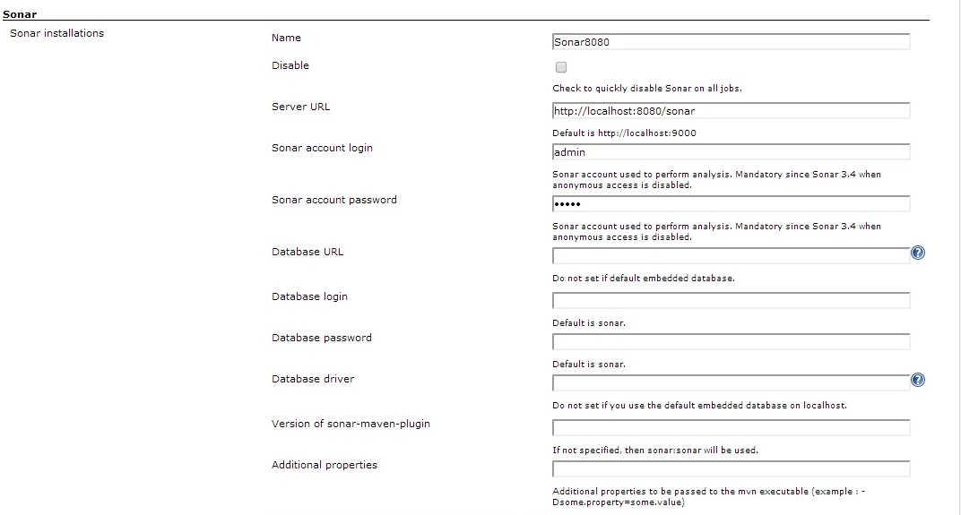
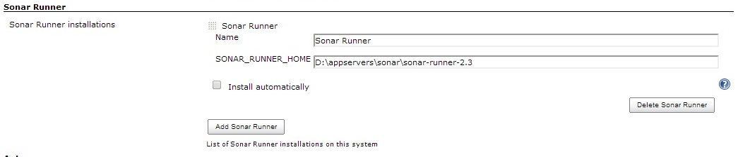
Jenkins and Sonar Configuration
Sonar Server Configuration Details where the SonarQube is running from Jenkins Configuration
Sonar Runner Configuration where the Sonar Runnier is available from Jenkins Configuration

Slide 26
Thank You

